Slide 1
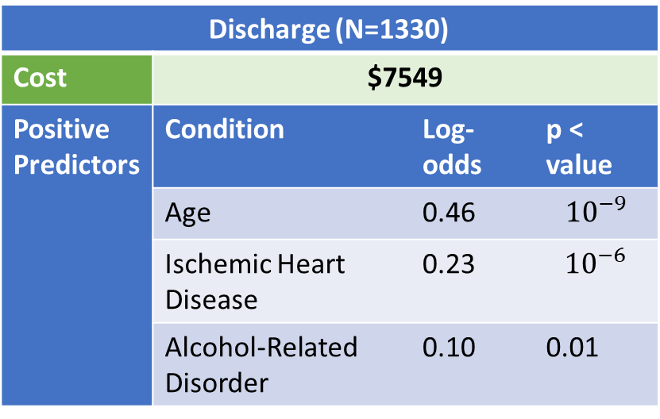
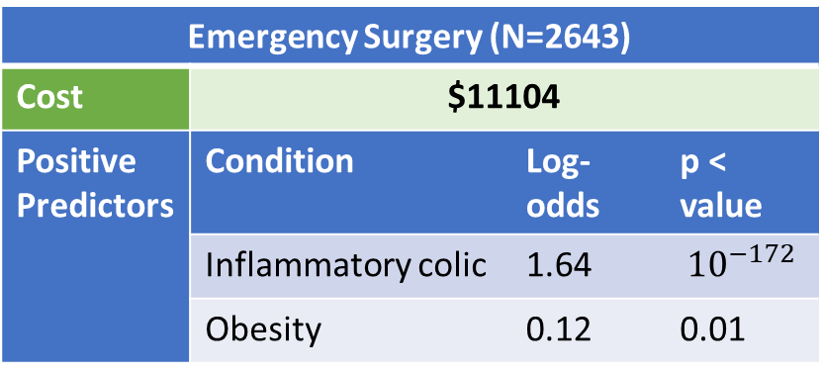

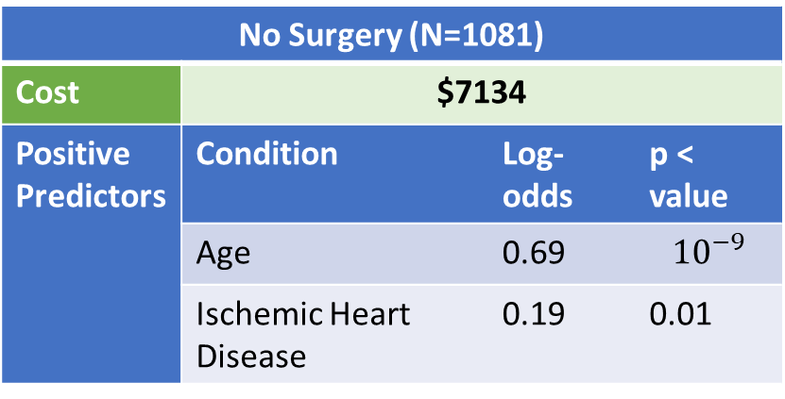
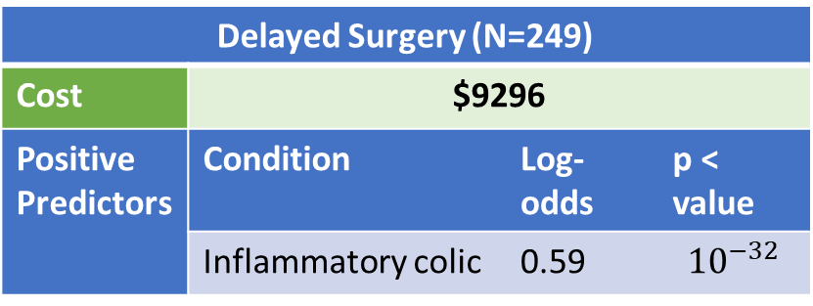
Emergency Surgery (N=2643) | Emergency Surgery
Cost | $11104
Positive Predictors | Condition | Log-odds | p < value
 | Inflammatory colic | 1.64 | $${10}^{−172}$$
 | Obesity | 0.12 | 0.01
Discharge (N=1330) | Emergency Surgery
Cost | $7549
Positive Predictors | Condition | Log-odds | p < value
 | Age | 0.46 | $${10}^{−9}$$
 | Ischemic Heart Disease | 0.23 | $${10}^{−6}$$
 | Alcohol-Related Disorder | 0.10 | 0.01
p < ${10}^{−36}$
VS
No Surgery (N=1081) | Emergency Surgery
Cost | $7134
Positive Predictors | Condition | Log-odds | p < value
 | Age | 0.69 | $${10}^{−9}$$
 | Ischemic Heart Disease | 0.19 | 0.01
Delayed Surgery (N=249) | Emergency Surgery
Cost | $9296
Positive Predictors | Condition | Log-odds | p < value
 | Inflammatory colic | 0.59 | $${10}^{−32}$$
p < 0.0001
VS

Slide 2
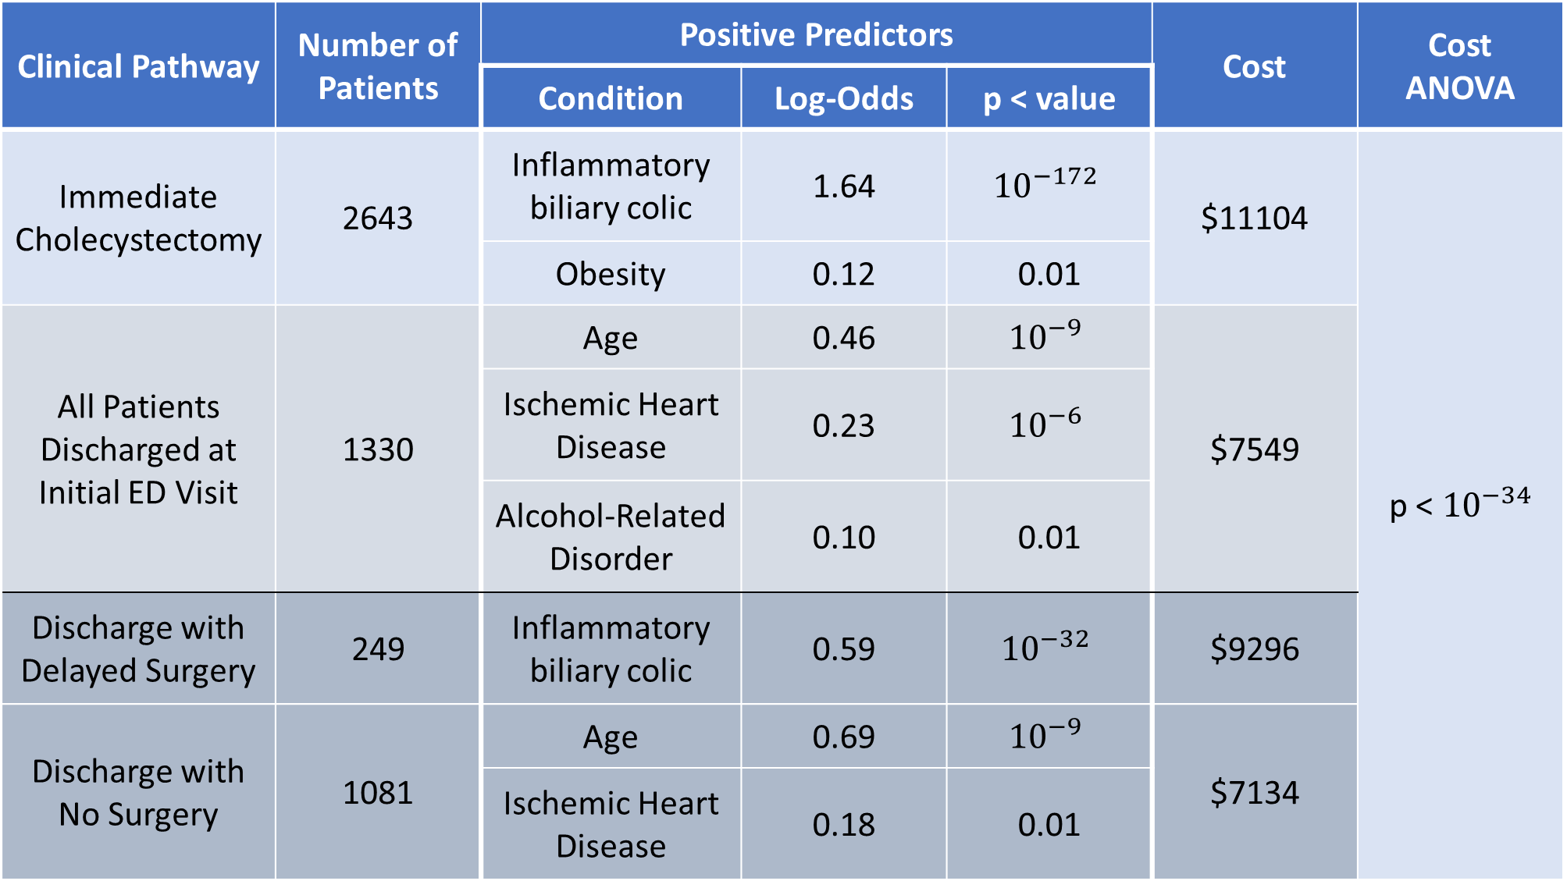
Clinical Pathway | Number of Patients | Positive Predictors |  |  | Cost | Cost ANOVA
 |  | Condition | Log-Odds | p < value
Immediate Cholecystectomy | 2643 | Inflammatory biliary colic | 1.64 | $${10}^{−172}$$ | $11104 | p < ${10}^{−34}$
 |  | Obesity | 0.12 | 0.01
All Patients Discharged at Initial ED Visit | 1330 | Age | 0.46 | $${10}^{−9}$$ | $7549
 |  | Ischemic Heart Disease | 0.23 | $${10}^{−6}$$
 |  | Alcohol-Related Disorder | 0.10 | 0.01
Discharge with Delayed Surgery | 249 | Inflammatory biliary colic | 0.59 | $${10}^{−32}$$ | $9296
Discharge with No Surgery | 1081 | Age | 0.69 | $${10}^{−9}$$ | $7134
 |  | Ischemic Heart Disease | 0.18 | 0.01

Slide 3
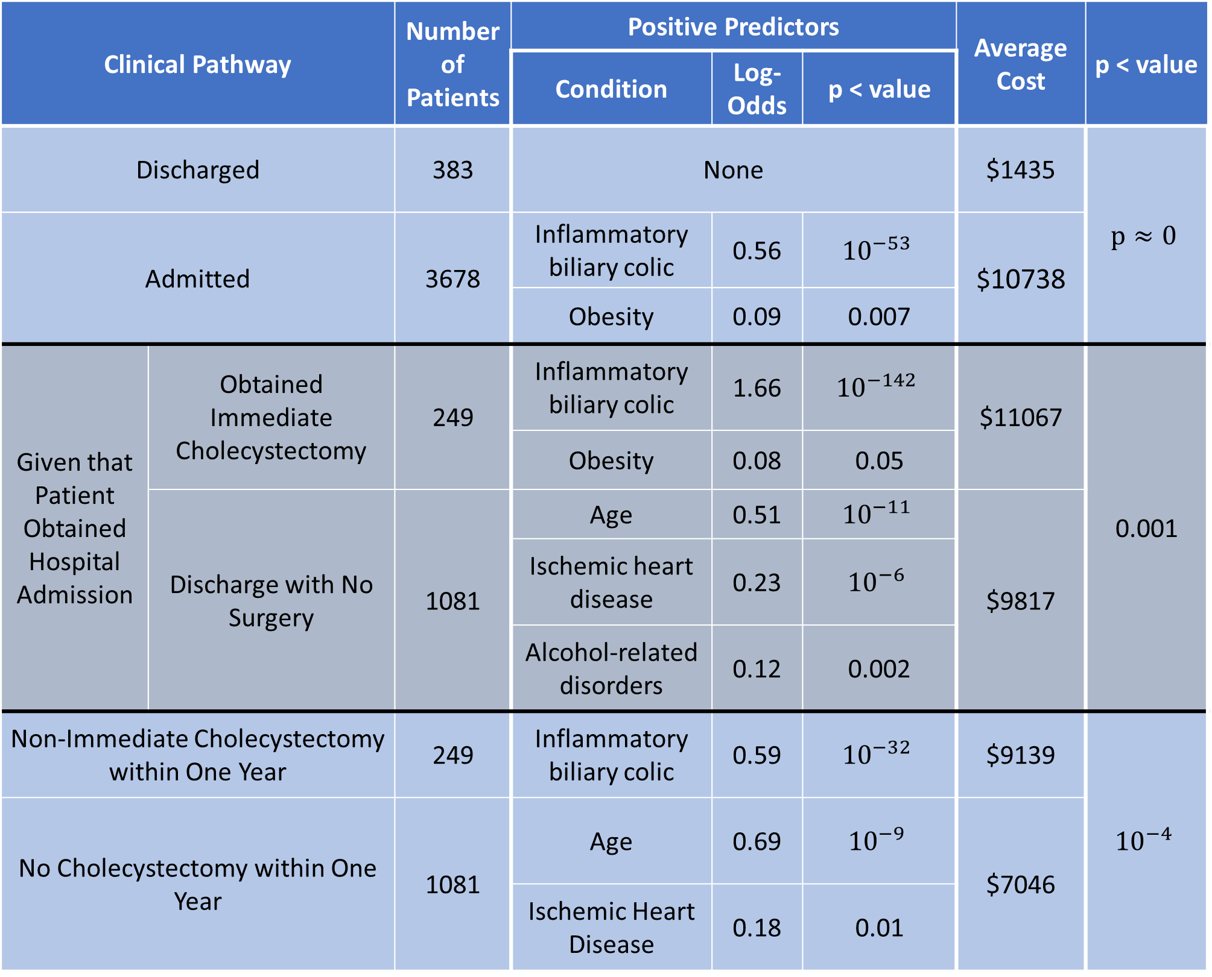
Clinical Pathway | Clinical Pathway | Number of Patients | Positive Predictors |  |  | Average Cost | p < value
 |  |  | Condition | Log-Odds | p < value
Discharged | Immediate Cholecystectomy | 383 | None |  |  | $1435 | $$p≈0$$
Admitted | All Patients Discharged at Initial ED Visit | 3678 | Inflammatory biliary colic | 0.56 | $${10}^{−53}$$ | $10738
 |  |  | Obesity | 0.09 | 0.007
Given that Patient Obtained Hospital Admission | Obtained Immediate Cholecystectomy | 249 | Inflammatory biliary colic | 1.66 | $${10}^{−142}$$ | $11067 | 0.001
 |  |  | Obesity | 0.08 | 0.05
 | Discharge with No Surgery | 1081 | Age | 0.51 | $${10}^{−11}$$ | $9817
 |  |  | Ischemic heart disease | 0.23 | $${10}^{−6}$$
 |  |  | Alcohol-related disorders | 0.12 | 0.002
Non-Immediate Cholecystectomy within One Year |  | 249 | Inflammatory biliary colic | 0.59 | $${10}^{−32}$$ | $9139 | $${10}^{−4}$$
No Cholecystectomy within One Year |  | 1081 | Age | 0.69 | $${10}^{−9}$$ | $7046
 |  |  | Ischemic Heart Disease | 0.18 | 0.01

